Slide 1
Using SVD for Recommender Systems
By Yaffa Atkins

Slide 2
GOAL:
The goal of a recommender system is to recommend new products to users or predict users interest in a product based on the user's previous behavior and interests, or based on the behavior and interest of similar users. However these datasets are sparse and have noisy data. SVD is used to remove less important features from the consideration making recommendations more accurate.
Solving this problem is important to data mining because data mining focuses on extracting and handling large data sets in order to understand the data, find patterns, and make better decision based off of them. The primary application of recommender systems is finding a relationship between users and products to maximise user-product engagement!
.

Slide 3
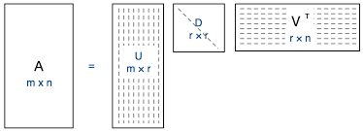
SOLUTION: SVD, Matrix Factorization
SVD accepts utility matrix A = rows represent users, columns represent items, values are the ratings given to each item by the users
SVD decomposes A into 3 matrices, A = UDV^T.
U represents the relationship between users and latent factors,
D describes the strength of each latent factor
V indicates the similarity between items and latent factors
Here, latent factors are the hidden features or characteristics of the items. The recommender system cannot identify those latent factors but it knowns they exist and it can categorize users or items based off of them.
Notes:
The latent factors here are the hidden features or characteristics of the items. The recommender system cannot identify those latent features but it knowns they exist and that they categorize users or items.

Slide 4
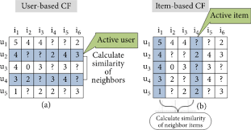
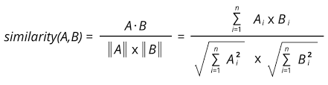
SOLUTION: Similarity
Find the cosine similarity between users or items based on the latent features
Recommend items that similar users enjoyed, or items similar to other items the user enjoyed.
Recommend the top similar items!

Slide 5
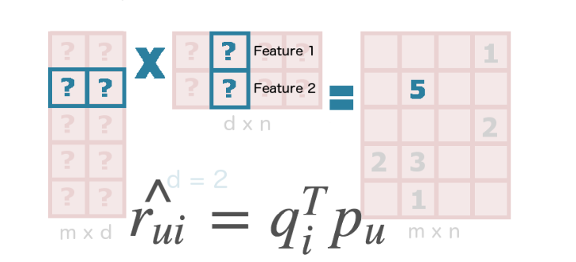

SOLUTION: Predict Rating
Multiply corresponding rows and columns to predict the rating of an item. Let each item be represented by a vector Qi and each user is represented by a vector Pu.
Error: Difference between predicted and actual rating
Add regularization and bias:

Slide 6
EXAMPLE: Movie Recommender
#Importing Libraries
import numpy as np
import pandas as pd
#Reading dataset (MovieLens 1M movie ratings dataset: downloaded from https://grouplens.org/datasets/movielens/1m/)
data = pd.io.parsers.read_csv('data/ratings.dat',
names=['user_id', 'movie_id', 'rating', 'time'],
engine='python', delimiter='::')
movie_data = pd.io.parsers.read_csv('data/movies.dat',
names=['movie_id', 'title', 'genre'],
engine='python', delimiter='::')
#Creating the rating matrix (rows as movies, columns as users)
ratings_mat = np.ndarray(
shape=(np.max(data.movie_id.values), np.max(data.user_id.values)),
dtype=np.uint8)
ratings_mat[data.movie_id.values-1, data.user_id.values-1] = data.rating.values
#Normalizing the matrix(subtract mean off)
normalised_mat = ratings_mat - np.asarray([(np.mean(ratings_mat, 1))]).T
#Computing the Singular Value Decomposition (SVD)
A = normalised_mat.T / np.sqrt(ratings_mat.shape[0] - 1)
U, S, V = np.linalg.svd(A)
#Function to calculate the cosine similarity (sorting by most similar and returning the top N)
def top_cosine_similarity(data, movie_id, top_n=10):
index = movie_id - 1 # Movie id starts from 1 in the dataset
movie_row = data[index, :]
magnitude = np.sqrt(np.einsum('ij, ij -> i', data, data))
similarity = np.dot(movie_row, data.T) / (magnitude[index] * magnitude)
sort_indexes = np.argsort(-similarity)
return sort_indexes[:top_n]
# Function to print top N similar movies
def print_similar_movies(movie_data, movie_id, top_indexes):
print('Recommendations for {0}: \n'.format(
movie_data[movie_data.movie_id == movie_id].title.values[0]))
for id in top_indexes + 1:
print(movie_data[movie_data.movie_id == id].title.values[0])
#k-principal components to represent movies, movie_id to find recommendations, top_n print n results
k = 50
movie_id = 10 # (getting an id from movies.dat)
top_n = 10
sliced = V.T[:, :k] # representative data
indexes = top_cosine_similarity(sliced, movie_id, top_n)
#Printing the top N similar movies
print_similar_movies(movie_data, movie_id, indexes)

Slide 7
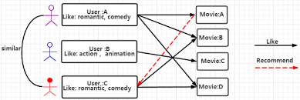
Recommend movies based on movies similar users liked. Interesting features would include keywords, cast, genres, and directors
Sort the data based on the ratings timestamp, selects the most recent ratings from each user as test set. This is more logical because the goal of recommenders is to rate un-encountered products in the future based on historical ratings of similar products.

Slide 8
What is non-trivial in the solution?
A lot of data is required because there are many items and often most users have not rated most items.
A lot of storage is necessary to store all of this data.
Separating the data based on the rating timestamp so we can predict the ratings of recent movies based on the ratings of historical movies is an added more complex step.

